Slide 1
Detect fake news using Spark NLP and deep learning models.
Trupesh Prajapati
240031105151010

Slide 2
Introduction
Fake News is a challenging problem in today's times.
Social Media websites are flooded with much misinformation, which can prove fatal.
Twitter particularly struggles with the fake news problem.
However, there is a certain regular pattern in fake news. Some individuals are more likely to spread fake news.
We can use Machine Learning to identify such patterns and try to predict fake news.

Slide 3
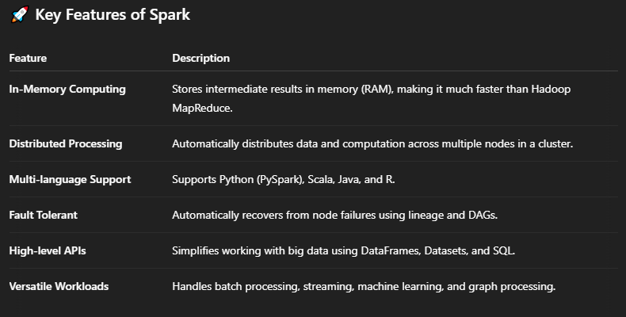
Introduction
What is Apache Spark?
Apache Spark is an open-source unified analytics engine designed for large-scale data processing. It was originally developed at UC Berkeley and is now one of the most widely used big data frameworks.

Slide 4
Introduction
Core Components of Apache Spark
Spark Core
The foundational engine for basic I/O, scheduling, task distribution, etc.
Spark SQL
Supports structured data processing with SQL queries and DataFrames.
Spark Streaming
Processes real-time data streams.
MLlib (Machine Learning Library)
Provides scalable ML algorithms like classification, regression, clustering.
GraphX
For graph computation and analysis (less commonly used today).

Slide 5
Project Objective
To develop a deep learning model that can accurately detect fake news.
Use spark natural language processing (spark NLP) techniques to analyze the content of news articles.
Demonstrate the application of Python, data preprocessing, and LSTM-based deep learning.

Slide 6
Dataset Description
Dataset includes labeled news articles (Real/Fake).
Fields include: id, title, and author.
Source: Kaggle or a similar public dataset repository.
Data Cleaning: removed null values and duplicates.

Slide 7
Data Preprocessing
Converted text to lowercase.
Removed punctuation, special characters, and stopwords.
Applied tokenization and padding.
Optional: Lemmatization or stemming for word normalization.

Slide 8
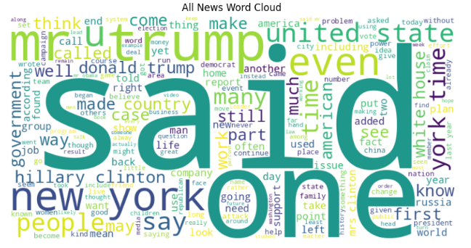
Exploratory Data Analysis (EDA)
Visualized the number of real vs fake news articles.
Identified most frequent words in each class.
Analyzed text length distributions.
Optional: Word clouds or bar graphs to show patterns.

Slide 9
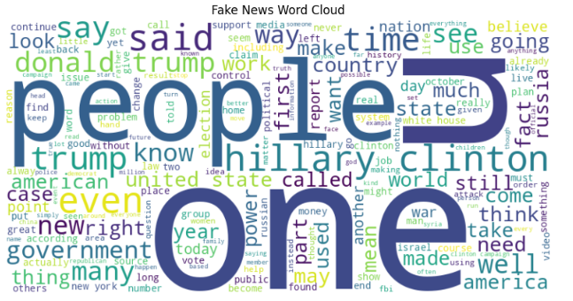
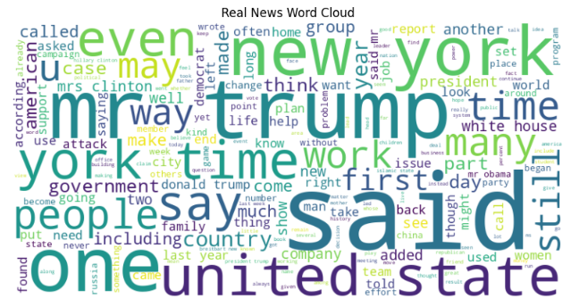
Exploratory Data Analysis (EDA)

Slide 10
Text Vectorization
Used Tokenizer to convert words to numeric sequences.
Applied padding to ensure equal input length for deep learning.
Optional: TF-IDF or Word2Vec for feature extraction.

Slide 11
Model Architecture
Used an LSTM (Long Short-Term Memory) network.
Model includes:
Embedding layer (for word vectors)
LSTM layer (for sequence learning)
Dense layer with sigmoid activation
Dropout layer used to prevent overfitting.

Slide 12
Model Compilation
Loss function: Binary Cross-Entropy (since it's a binary classification task).
Optimizer: Adam (adaptive learning).
Metrics: Accuracy, Precision, Recall, F1-score (optional).

Slide 13
Model Training
Split data into training and validation sets.
Trained model for 10 epochs with a batch size of 366.
Observed accuracy/loss curves for overfitting/underfitting.
EarlyStopping callback used to stop training when validation loss stops improving.

Slide 14
Model Evaluation
Evaluated performance using test data.
Metrics: Accuracy, Precision, Recall, F1-Score.
Visuals: Confusion Matrix to show true/false positives/negatives.
Optional: ROC curve to evaluate classification threshold.

Slide 15
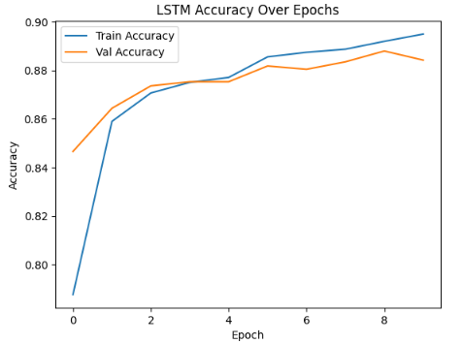
Results and Observations
Achieved 89% accuracy on test set.
The model performs better on Real/Fake (mention any bias).
Misclassifications typically involve ambiguous or satire content.

Slide 16
Conclusion
Successfully implemented a deep learning model for fake news detection.
Highlighted importance of data preprocessing and model tuning.
Showcased Python, Spark NLP, and deep learning integration.

Slide 17
Future Work
Improve dataset size and diversity.
Use advanced models (e.g., BERT, GPT-based transformers).
Implement real-time fake news detection tool.
Explore multilingual fake news detection.

Slide 18


